Slide 1
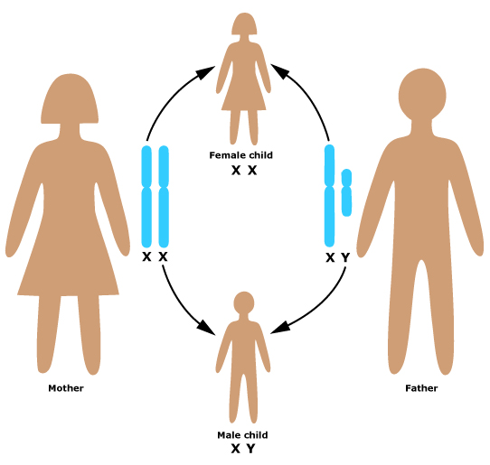
SEX DETERMINATION
The sex of an individual is determined by the sex chromosomes contributed to the zygote by the sperm and the egg

Slide 2
Remember:
Of our 23 pairs of chromosomes, 22 of them are homologous (identical)
Only the 23rd pair, the sex chromosomes are not matching.

Slide 3
SEX DETERMINATION
An egg can donate an X
A sperm can donate an X or Y
Therefore the sperm determines the sex of a child

Slide 5
SEX-LINKED INHERITANCE
Using fruit flies as test subjects, Thomas Morgan studied eye colour.
Red eyes (R) are dominant over white eyes (r).

Slide 6
SEX-LINKED INHERITANCE
When he crossed purebred white-eyed males with red-eyed females, he was unable to produce a female with white eyes.
He concluded that the gene must be located on the X chromosome.

Slide 7
SEX-LINKED INHERITANCE
Some traits are located on the sex chromosomes, so the inheritance of these traits depends on the sex of the parent carrying the trait.

Slide 8
SEX-LINKED INHERITANCE
Most known sex-linked traits are X-linked (carried on the X chromosome). This is probably because the X chromosome is much larger than the Y chromosome.

Slide 9
SEX-LINKED DISORDERS
Some sex-linked traits are associated with disorders.
Most are found on the X chromosome, Y-linked disorders are rare.
Males are at a much greater risk for inheriting sex-disorders because they only inherit one X, so if the X has the allele for the disorder, they will suffer from the disorder.
Recessive lethal X-linked traits result in death.

Slide 10
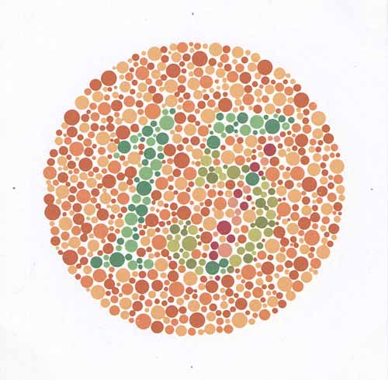
EXAMPLES OF SEX-LINKED TRAITS and DISORDERS
Male pattern baldness, red-green colour blindness, myopia, night blindness, hemophilia

Slide 11
SEX-LINKED INHERITANCE
Punnett squares are used to predict the outcome of sex-linked inheritance.
Assume the trait is X-linked unless told otherwise!
Most disorders are recessive, some are dominant, the question will tell you.
A “carrier” is a female who is heterozygous for the trait.

Slide 12
EXAMPLE
Hemophilia is a recessive X-linked trait. What is the probability of a couple having a hemophiliac child if the man does not have hemophilia and the woman is a carrier?

Slide 13
Sex determination
TED Ed - Sex Determination

