Slide 1
Safety In the Science Lab
Lab Safety: Everyone Is Responsible!
Rules and Symbols

Slide 2
Safety First
Science is a hands-on laboratory class.
You will be doing laboratory activities, which may require the use of hazardous chemicals and expensive lab equipment.
Safety in the science classroom is the #1 priority.
To ensure a safe science classroom, a list of rules has been developed.
These rules must be followed at all times.

Slide 3
General Safety Guidelines
Be Responsible at All Times. No horseplay, practical jokes, pranks, etc.
Follow all instructions carefully.
Do not play with lab equipment until instructed to do so.
Food, drink, and gum are not allowed in the science classroom during a lab.
Lab Safety: Everyone Is Responsible!
Notes:
Verbal & written directions. If you don’t understand ask for help.
Do not do any experiments without teacher approval.

Slide 4
General Safety Guidelines
Keep the science room clean and organized.
Notify the teacher immediately of any accidents or unsafe conditions in the science classroom!
Wash your hands with soap and water after experiments.
Lab Safety: Everyone Is Responsible!
Notes:
Keep aisles clear, wash equipment, put notebooks in desks, etc.

Slide 5
Safety Symbols
Eye Protection
Wear safety goggles when working with chemicals, flames, or heating devices.
If a chemical gets in your eye, flush in water for 15 minutes and notify the teacher.
Sharp Objects
When using knifes or other sharp objects always walk with the points facing down.
Cut away from fingers and body.
Electrical Safety
Do not place a cord where someone can trip over it.
Never use electricity around water.
Unplug all equipment holding the plug, not pulling on the cord.

Slide 6
Safety Symbols
Heating Safety
Tie back hair and loose clothes when working with open flames.
Never look into a container as you are heating it.
Heated metal and glass looks cool, use tongs or gloves before handling.
Never leave a heat source unattended.

Slide 7
Safety Symbols
Chemical Safety
Read all labels twice before removing a chemical from the container.
Never touch, taste, or smell a chemical unless instructed by the teacher.
Transfer chemicals carefully!
Hand Safety
If a chemical spills on your skin, notify the teacher and rinse with water for 15 minutes.
Carry glassware carefully.

Slide 8
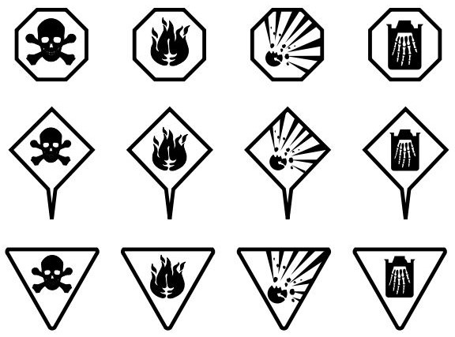
Symbols to know
Poison
Flammable
Explosive
Corrosive
Danger
Warning
Caution

Slide 9
Safety Equipment
Fire Blanket – Located in back of classroom in the red container
Fire Extinguisher – Located in outside classroom door and in the computer lab
To operate the fire extinguisher remember P-A-S-S
P- Pull the Pin
A-Aim the hose at the base of the fire from 5-6 feet away.
S-Squeeze the handle.
S-Sweep the hose back and forth across the fire.
On Fire?
REMEMBER: Stop, Drop, & Roll

