Slide 1
Genes + Alleles = Traits

Slide 2
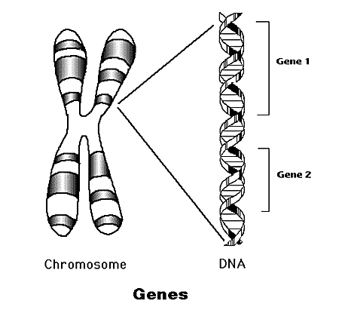
What is a gene?
A gene is a piece of DNA that tells a cell to make a certain type of protein.
Genes are found on all of our chromosomes.
Our DNA can make over 100 000 types of proteins and these determine our traits.
Our traits are our genetically determined characteristics: height, hair colour, eye colour, skin colour, gender, etc…

Slide 3
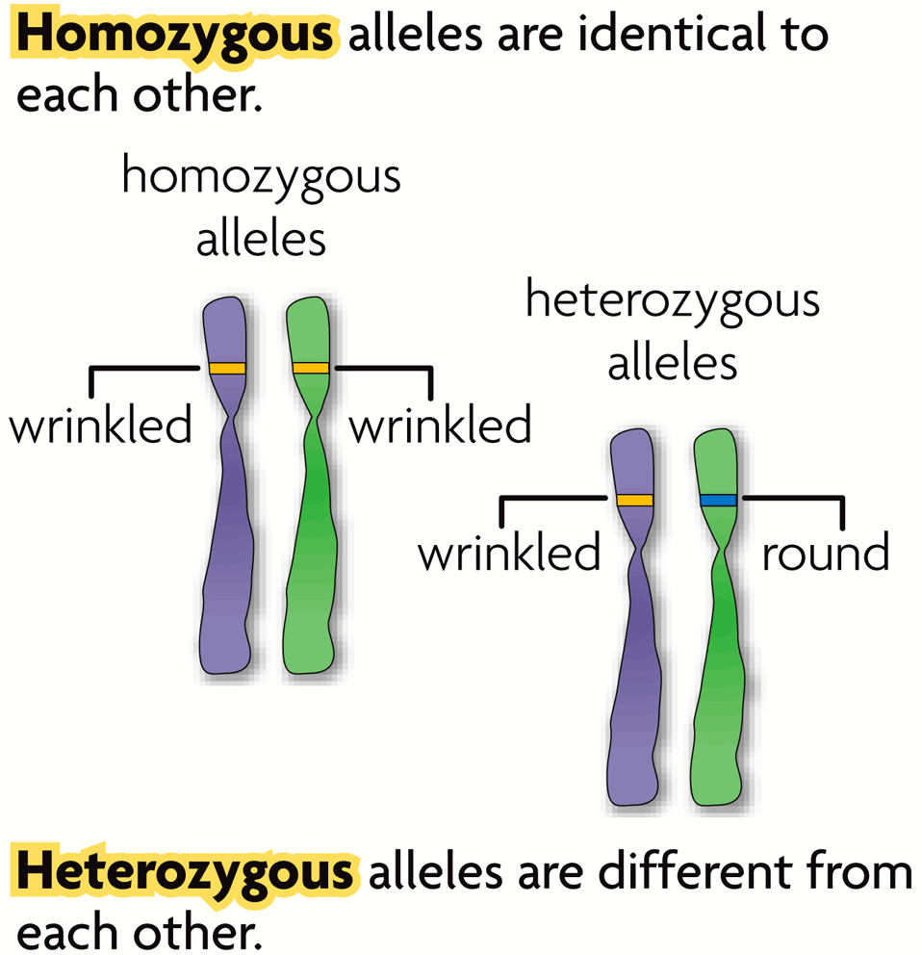
An allele is an alternative form of a gene.
Each parent donates one allele for every gene.
Pea plants have 2 alleles for shape, they receive one from each parent
For shape, there is a
Round allele
Wrinkled allele

Slide 4
Dominant vs. Recessive
Dominant - Masks the other trait; the trait that shows if present
Represented by a capital letter
Recessive – An organism with a recessive allele for a particular trait will only exhibit that trait when the dominant allele is not present; Will only show if both alleles are present
Represented by a lower case letter
R
r

Slide 5
KEY PIECE OF LEARNING #1
THE SAME GENE CAN HAVE MANY DIFFERENT VERSIONS.
These variations are caused by alleles.
Alleles are either dominant or recessive.
Alleles can be homozygous when both genes have the same alleles
Homozygous Dominant (RR)
Homozygous Recessive (rr)
Alleles can by heterozygous, when the genes have different alleles (Rr or rR)

Slide 6
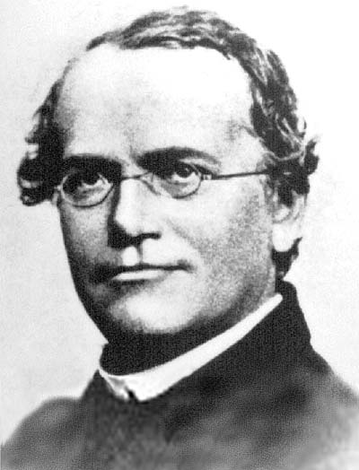
Why are we talking about peas?
Gregor Mendel, 1822-1884), was an Austrian monk who studied the inheritance of traits, used pea plants for his research.
His research laid the foundation for modern genetics.
Why peas?
They grow fast, so you can get lots of data
They have many either/or traits:
Either tall OR short, no in-between
Either purple OR white flowers, no in-between

Slide 7
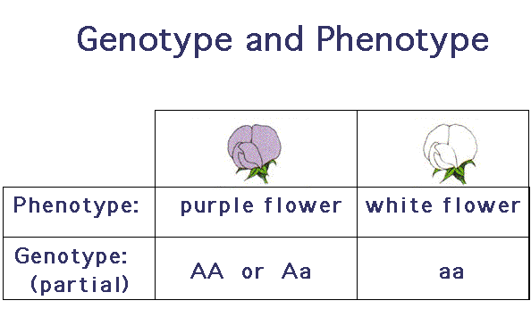
Genotype and Phenotype
Genotype – The genetic makeup of an organism; the gene (or allele) combination an organism has.
Example: Tt, ss, GG, Ww
Phenotype – The physical characteristics of an organism; The way an organism looks
Example: Curly hair, straight hair, blue eyes, tall, green

Slide 8
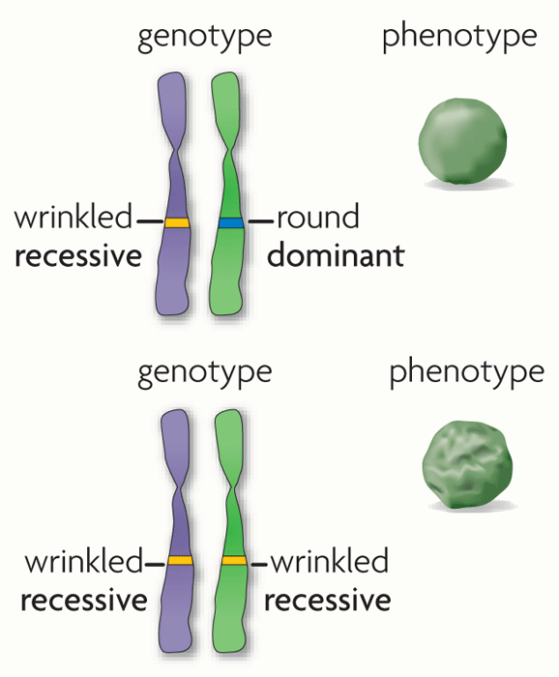
A dominant allele is expressed as a phenotype when at least one allele is dominant
A recessive allele is expressed as a phenotype only when two copies are present

Slide 9
QUICK REVIEW EXAMPLE
Tall (T) or short (t) allele
If a person has two dominant alleles (TT) – they will be tall
If a person has two recessive alleles (tt) – they will be short
If a person has 1 dominant and 1 recessive allele (Tt) – they will be tall, because the dominant allele masks the recessive allele.

Slide 10
Some practice
TT - Represent offspring with straight hair
Tt - Represent offspring with straight hair
tt - Represents offspring with curly hair
T – straight hair
t - curly hair

Slide 11
Mendel’s Rules
Law of Segregation – Two alleles for each trait separate when gametes form; Parents pass only one allele for each trait to each offspring
Law of Independent Assortment – Genes for different traits are inherited independently of each other
Law of Dominance - When a dominant trait is present the recessive trait is hidden

