Slide 1
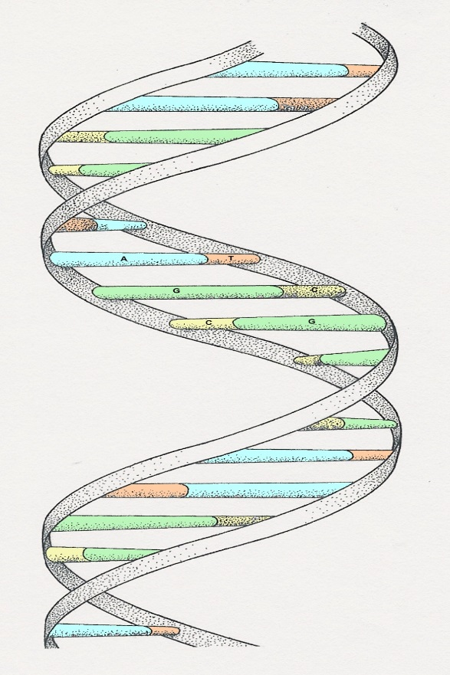
DNA
THE BUILDING BLOCKS FOR ALL LIFE
Notes:
The illustration is a ‘model’ of the double helix forming part of a DNA molecule
(Slide 14)

Slide 2
DNA
DNA stands for deoxyribonucleic acid
This chemical substance is present in the nucleus of all cells in all living organisms.
DNA controls all the chemical changes which take place in cells.
DNA dictates what kind of cell is formed (muscle vs blood, vs nerve)
Our complete DNA forms our GENOME.

Slide 3
What makes up a DNA molecule
DNA is a very large molecule made up of a long chain of sub-units
These sub units are called nucleotides.
Each nucleotide is made up of
A sugar called deoxyribose
A phosphate group (PO₄)
An organic base

Slide 4
Deoxyribose and phosphates
Deoxyribose is a sugar, very similar to glucose, and provides the structural support for the DNA molecule.
The Phosphate group (PO4), also acts as structural support.
In DNA drawings, the Deoxyribose is usually drawn with a pentagon.

Slide 5
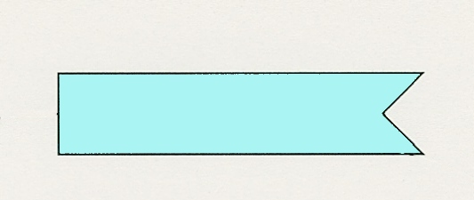
The 4 organic bases
Adenine
(A)
Thymine
(T)
Cytosine
(C)
Guanine
(G)

Slide 6
Nucleotides
The deoxyribose, the phosphate, and one of the bases combine to form a nucleotide.
PO₄
adenine
deoxyribose
Notes:
It is the phosphate group which gives DNA its acidic properties

Slide 7
Joined nucleotides
PO₄
A molecule of DNA is formed by millions of nucleotides joined together in a long chain
PO₄
PO₄
PO₄
sugar-phosphate
backbone
+ bases

Slide 8
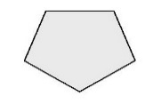
2-stranded DNA
PO₄
PO₄
DNA consists of a double strand of molecules.
The sugar phosphate chains are on the outsides (the strands) and are held together by the hydrogen bonds between the bases.
PO₄
PO₄
PO₄
PO₄
PO₄
PO₄
PO₄
PO₄

Slide 9
Complimentary Pair Bonding
The bases always pair up in the same way
Adenine forms a bond with Thymine
Adenine
Thymine
and Cytosine bonds with Guanine
Cytosine
Guanine

Slide 10
Base Pair Bonding
PO₄
PO₄
adenine
thymine
PO₄
PO₄
cytosine
guanine
PO₄
PO₄
thymine
adenine
PO₄
PO₄
guanine
cytosine

Slide 11
The Double Helix
DNA molecules spiral around themselves to form a Double Helix.
Roughly 6 feet of DNA strand is coiled inside the nucleus of every cell in our bodies.
The discovery of the DNA double helix was revolutionary and was awarded the Nobel Prize.

Slide 12
From nucleotides to amino acids
A group of three bases, called a triplet, controls the production of a particular amino acid in the cytoplasm of the cell.
The different amino acids and the order in which they are joined up determines the sort of protein being produced.
The sequence of bases in DNA forms what is called the Genetic Code.

Slide 13
Triplet code
Each triplet codes for a specific amino acid. For example:
CAA – CAC – CCA – CCA – GGG – GAG – GCA
The amino acids are joined together in the correct sequence to make part of a protein
ALA-VAL-GLY-GLY-ARG-PRO-LEU strings together to form part of a protein.
Ala
Val
Gly
Gly
Arg
Pro
Leu
Notes:
Although the DNA in the nucleus specifies the amino acids and their sequence, it is in the cytoplasm that the protein build-up takes place. The DNA of the nucleus makes a single strand of messenger RNA (ribo-nucleic acid) which leaves the nucleus and builds up the protein in the cytoplasm. The RNA code is complementary, but not identical, to the nuclear DNA. Text books usually give the coding for the RNA but in this presentation it is for the DNA itself

Slide 14
DNA and enzymes
Proteins build all the different structures in the cells
Proteins also make enzymes
The DNA controls which enzymes are made and the enzymes determine what reactions take place throughout the body.
This helps create all the different types of cells within an organism (heart cell, brain cell, skin cell, etc…)
DNA exerts its control over the entire human body through enzymes.
UP NEXT: Chromosomes, Genes and Alleles

