Slide 1
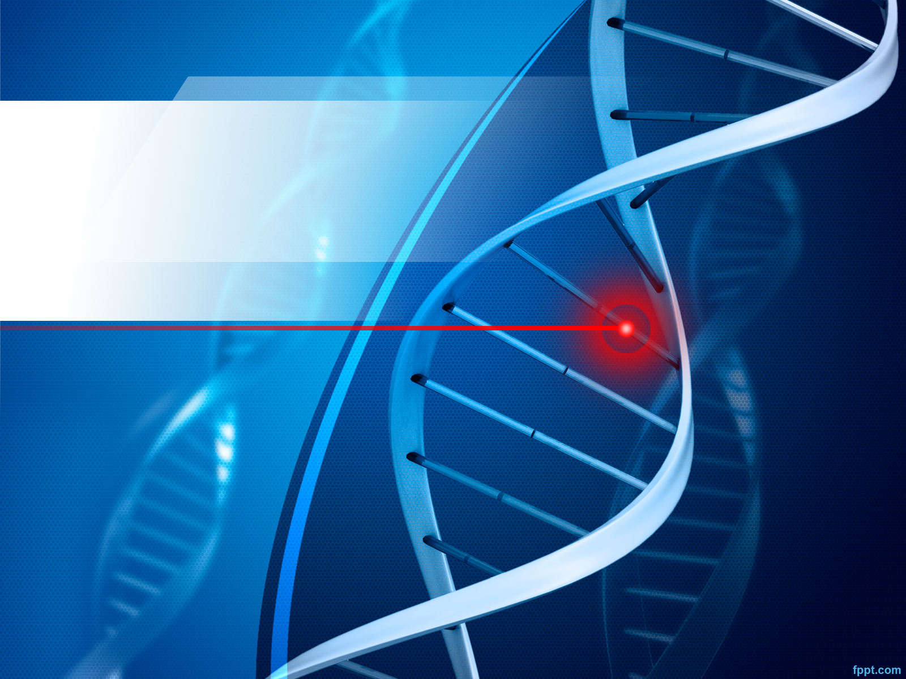
Chromosomes, Genes and Alleles

Slide 2
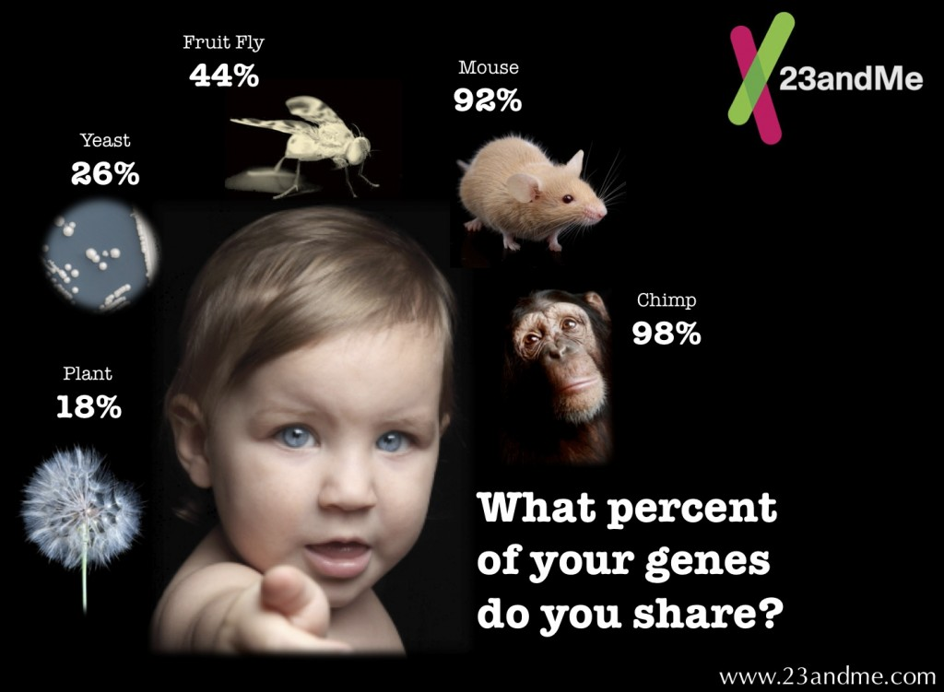

Slide 3
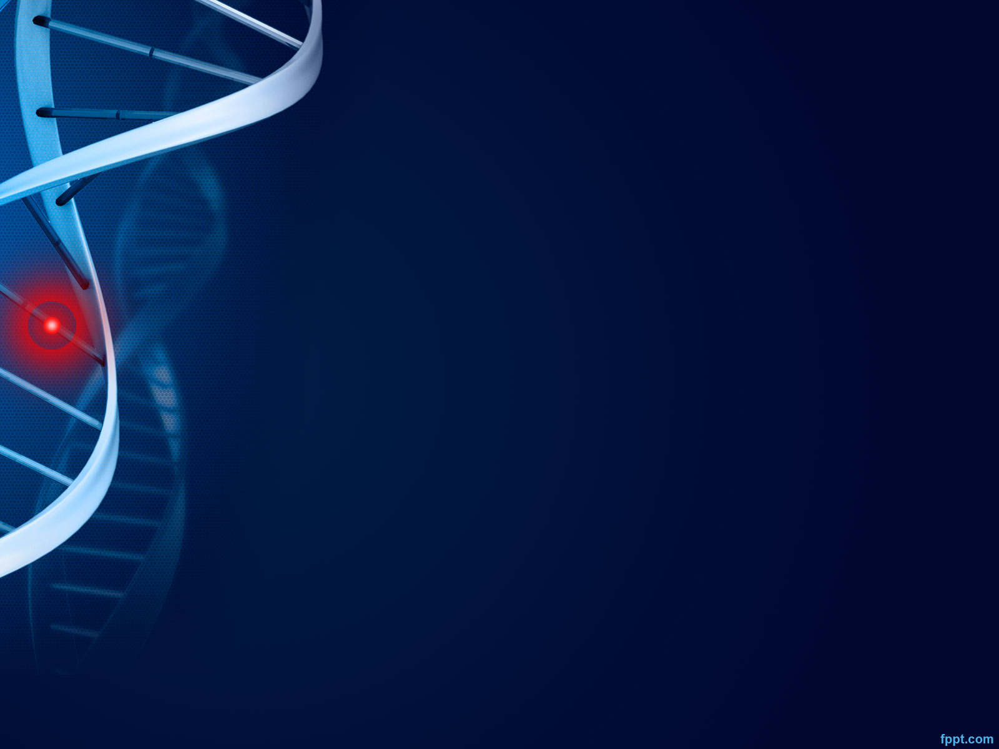
How do we get from DNA to all these different human bodies?
DNA is coiled tightly into large threadlike structures called chromosomes found in the nucleus of all cells.
Most humans, in almost every cell, have 23 chromosome pairs, for a total of 46 chromosomes.
22 of those pairs are identical.
The 23rd pair are the sex cells, which can either be XX for female, or XY for male.

Slide 4
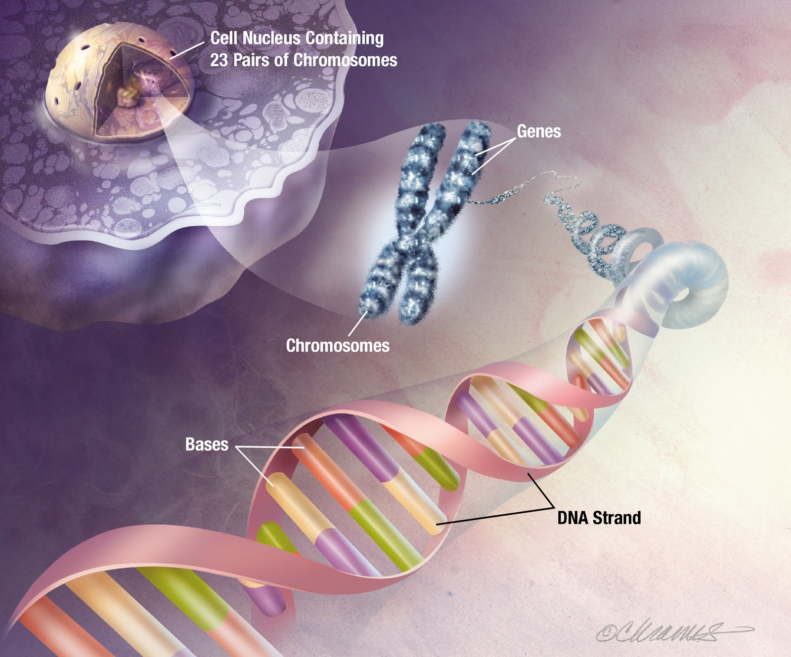

Slide 5
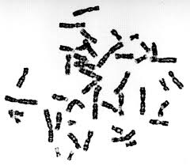
KARYOTYPE
A karyotype is a visual image containing all the chromosomes in a cell’s nucleus.
A regular human cell would have 23 pairs of chromosomes, or 46 total chromosomes.
A pair of matching chromosomes are called HOMOLOGOUS chromosomes.

Slide 6
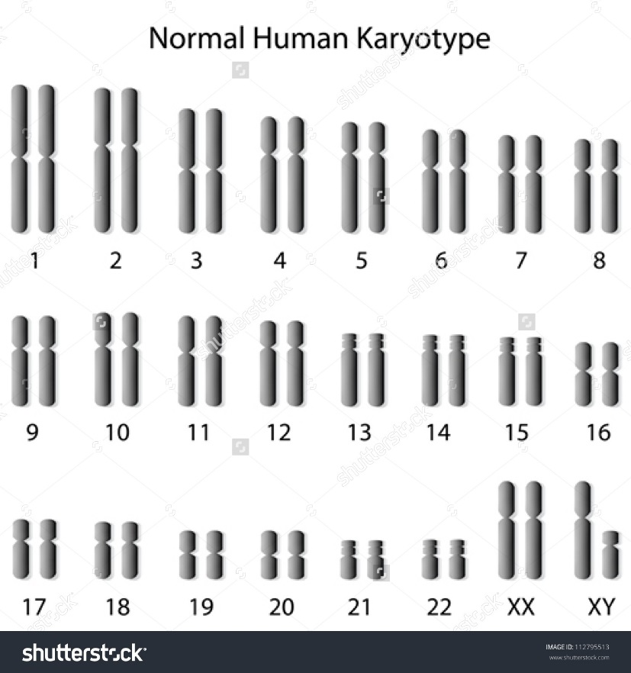
Karyotype: a picture of your chromosomes

Slide 7
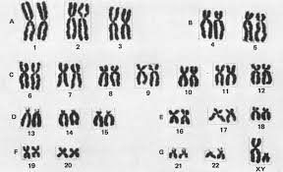
X-Shaped Chromosome Karyotype (during replication phase)

Slide 8
Haploid vs Diploid
Almost all cells in our bodies are diploid cells. This is because our cells contain matched pairs of chromosomes, one from our mother and one from our father.
The only haploid (single unpaired chromosome) cells in our bodies are our sex cells (sperm and egg cell), which will combine when reproduction occurs.
Wait…what?

Slide 9
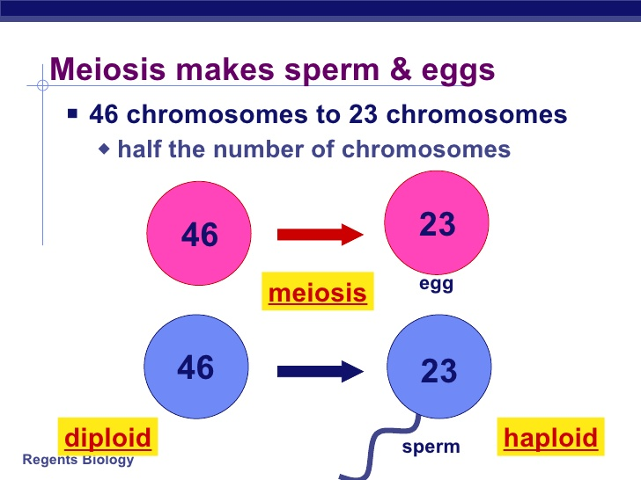
MEIOSIS
Meiosis creates sex cells (sperm and egg)
It starts with diploid cells that contain 46 chromosomes.
It creates haploid cells that only contain 23 chromosomes.

Slide 10
INTERPHASE
Interphase: Chromosomes replicate and go from single strand to the X-shape, called a sister chromosome
Red = father line
Blue = mother line

Slide 11
MEIOSIS 1
Meiosis 1: Replicated chromosomes cross over, exchanging genetic material and separate
These new daughter chromosomes are genetically different from their parent chromosomes.

Slide 12
MEIOSIS 2
The sister chromosomes separate and form 2 new cells, each containing a single strand chromosome.
The end result is 4 sex cells, called gametes, where are each genetically unique.
This allows for genetic variation amongst siblings.

Slide 13
Interesting Fact!
Interestingly, for men, meiosis that starts with one cell results in 4 gametes (4 sperm)
However, in women, meiosis that starts with one cell results in only 1 gamete (1 egg). The other 3 cells do not develop into gametes.

Slide 14
TO REVIEW

Slide 15
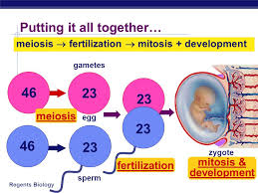
Then, when people have special feelings for each other…
When a zygote is created, 23 chromosomes from the male combine with 23 chromosomes from a female and VOILA!
A genetically unique new zygote is created!

