Slide 1
Bohr and Lewis Diagrams
Properly drawing atoms!

Slide 2
What is a Bohr Diagram?
Niels Bohr (1885-1962) discovered that electrons were arranged in energy levels/specific patterns (aka: energy shells!)
Bohr Diagram = a diagram that shows how many e- are in each shell surrounding the nucleus

Slide 3
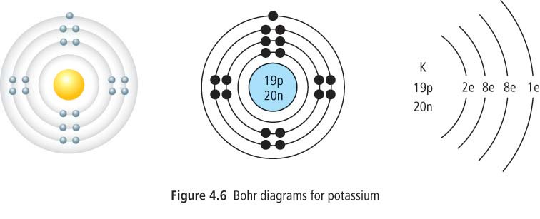
Bohr Diagram
These are 3 different ways to show the same thing: a Bohr Diagram of Potassium (K)

Slide 4
Rules for Bohr Diagrams
1st Shell = 2
2nd Shell = 8
3rd Shell = 8
4th Shell = 18

Slide 5
How to draw a Bohr Diagram
Figure out how many protons, electrons and neutrons are in the element
Draw the nucleus
a. Draw a circle and write the symbol, number of p+ and number of n in the middle of it
Draw the energy shells
a. Draw circles around the nucleus
Draw dots on the energy shells, each dot representing an electron
a. Remember, only 2 max in the first shell, 8 max in the rest

Slide 6
Vocab
Valence Shell = the outermost shell that contains electrons
Valence Electron = the electrons in the outermost shell
These are the e- involved in chemical bonding
Stable Octet = an element with a full outer shell (8 electrons in its valence shell)

Slide 7
Patterns in Electron Arrangements
The period number of an element = the number of shells involved with it
Ex: Be is in period 2, so it has 2 occupied shells
(Except for the transition elements), the last digit of the group number = the number of e- in the valence shell
Ex: Chlorine is in group 17, so it has 7 e- in its valence shell

Slide 8
Ions
Atoms can gain or lose electrons
This causes them to become electrically charged
IONS = electrically charged atoms that have gained or lost electrons
Notes:
Remember that an atom is neutral because the positive proton charged and the negative electron charges = zero… so if you add or subtract an electron, the atom’s charge no longer equals 0

Slide 9
Ions
Atoms will either lose some electrons or gain some electrons to become more stable
The most stable state for an atom is with a full octet (8 electrons in its valence shell)
The Noble Gases are all stable octets. Other atoms will gain or lose electrons to be stable like their nearest noble gas is

Slide 10
CatIONS
Metal atoms lose e- to form positively charged cations
Example: Na loses 1 electron to become the ion Na ⁺

Slide 11
AnIONS
Non-metal atoms gain e- to form negatively charged anions
Example: Cl loses 1 picks up 1 electron to become the ion Cl⁻

